Slide 1
Business Architecture Development
Service Offering
Information Packet
Proprietary and Confidential to

Slide 2
Definition
Value Proposition
Approach
Roles & Workplan
Case Studies
Sample Deliverables
Job Aids
Proprietary and Confidential to

Slide 3
Definition
The Business Architecture service offering will define how new business capabilities and their relationships will be implemented and how they will operate.
Ensures that all aspects of the new capability are addressed to provide significant and sustainable value
The Business Architecture is made up of the following components:
Proprietary and Confidential to

Slide 4
Definition
The Business Architecture Offering occurs during the last stage of the BIM Planning Phase.
Plan and Manage Solution Planning
Understand Sponsor
Goals and Expectations
Define Value Proposition
Define Business Case
Plan Value Realization
Identify and Resolve Gaps
Understand Strategic Context and Intent
Define Business Capability Requirements
Define and Integrate Business Architecture
Identify Performance Improvement Opportunities
Evaluate and Recommend Value Creating Opportunities
Develop Operating Strategy
Define Business Architecture
Scope and Performance
Define Business Capability (Service Operations) Blueprints
Validate Business Architecture
Assess Internal Context
Assess
Current Capabilities
Proprietary and Confidential to

Slide 5
Definition
Value Proposition
Approach
Roles & Workplan
Case Studies
Sample Deliverables
Job Aids
Proprietary and Confidential to

Slide 6
Value Proposition
A properly defined and executed Business Architecture will:
Align the capabilities with the operating vision.
Design capabilities to achieve the business performance objectives that deliver bottom line results.
Integrate key business practices in the business architecture.
Proprietary and Confidential to

Slide 7
Definition
Value Proposition
Approach
Roles & Workplan
Case Studies
Sample Deliverables
Job Aids
Proprietary and Confidential to

Slide 8
Approach
Identify and Resolve Gaps
Gap Closure Approach
Define Business
Capability
Requirements
Define and
Integrate
Business
Architecture
Define Business
Architecture Scope
and Performance
Define Business
Capability
Blueprints
Validate Business
Architecture
Update Bus Capability Definition
Update Bus Performance Model
Business Architecture Blueprint
Update Business Performance Model
Bus Arch Scope Definition
Create Bus Capability Definition
Bus Capability Relationship Diagram
Create Business Performance Model
Business Capability Blueprint
Complete Business Capability Definition
Complete Business Performance Model
Business Arch Executive Presentation
Assess Current Capabilities
Bus Arch Current Assessment
Bus Arch Current Assessment Approach
Proprietary and Confidential to

Slide 9
Definition
Value Proposition
Approach
Roles & Workplan
Case Studies
Sample Deliverables
Job Aids
Proprietary and Confidential to

Slide 10
Organization Chart
Steering Committee
1Client Executive
Program Manager
1Client
1 AC Market Unit Manager/AP
Project Management
1Client Manager
2 AC EBS Manager
Technical Design Team
Process Team
Change Management Team
2Clients
2 AC EBS
2Clients
2 AC EBS/Market Unit
1Clients
1 AC EBS
Subject Matter Experts
AC Solution Center Network
Note: Team size is dependant on scope of project.
Proprietary and Confidential to

Slide 11
Roles & Responsibilities
Position
Responsibilities
Area of Expertise
Commitment
Steering Committee
Final decisions
Directions setting
Champion driver
Enterprise
Part Time
Project Manager
Schedule and quality review
assurance
Enterprise wide change
initiatives
Full Time
Project Management
Manages project and resources
Resource provider
Project communication
Deliverable quality and consistency
Manager of workplan, deliverables,
schedule
Enterprise wide change
initiatives
Best Practices
ERP Experience
BI Architecture
Full Time
Business Integration
Team (Process, Change,
Technology)
Bus capability definition
Bus arch Scope definition
Bus performance model
Bus arch current assessment &
Approach
Bus arch blueprint
Bus capability blueprint
Expertise in appropriate
competency
Industry Experience
ERP Experience
Best Practices
BI Architecture
Client Part Time
AC Full Time
Subject Matter
Experts
Provide subject matter expertise
Expertise in appropriate
subject matter
Part Time
AC Solution Center
Network
Provide subject matter expertise
Expertise in appropriate
ERP package
Part Time
Proprietary and Confidential to

Slide 12
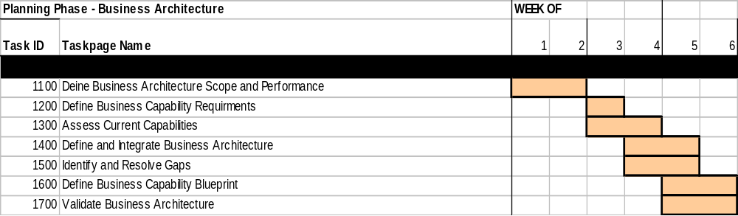
Workplan
The Business Architecture service offering is located in the Planning Phase of Business Integration Methodology. Typical engagements last between 4-6 weeks. The development timeframe varies based on the number of capabilities to architect and the size of the project team. The project is very aggressive and the client must be totally committed to the schedule.
Proprietary and Confidential to

Slide 13
Definition
Value Proposition
Approach
Roles & Workplan
Case Studies
Sample Deliverables
Job Aids
Proprietary and Confidential to

Slide 14
Case Study
Communication Company
Company Background:
Highly distributed work environment; not organized by cross-disciplinary teams
Lacking integration to supply chain system
Recently acquired other companies which caused difficulty in thinking holistically
Difficulty with defining capabilities and dependencies
Objective:
Provide a disciplined, up front thinking about how the new capabilities will be implemented and how they will operate
Identify dependencies between new and current capabilities
Study the feasibility of using an ERP package to achieve a consolidated, integrated, and more profitable supply chain management system
Approach:
Defined business architecture scope and performance
Defined business capabilities and requirements
Defined business architecture and resolved gaps
Defined business capability blueprint and validate business architecture
Value Delivered:
Provided a solid foundation for the ERP software assessment phase
Provided ERP expertise
Delivered a validated business architecture in 4 weeks
Proprietary and Confidential to

Slide 15
Definition
Value Proposition
Approach
Roles & Workplan
Case Studies
Sample Deliverables
Job Aids
Proprietary and Confidential to

Slide 16
Sample Deliverable - Business Integration Blueprint
The following is an example of a business integration blueprint (I.e. Preventive Maintenance Plan). It highlights the dependencies between the elements which must be integrated for the organization to operate most effectively.
Culture
Proactive behavior
Innovative thinking is promoted and rewarded
Strategy
Organization
Competency
Performance
Disciplined maintenance management
Shift from reactive to predictive and preventative
Shared Maintenance Planning (downtime) supporting multiple sites
Integrated Maintenance Planning & Production Scheduling teams
Asset knowledge to answer technical questions
Multi -skilled crafts
Cost / performance trade-off decision making
Unscheduled downtime vs. target
Site efficiency vs. target
Improvements in maint. productivity
Process
Application
Predictive & Preventive Maintenance
Work Order Planning
Crew Planning & Scheduling
Asset Database
Work Order Database
Crew Database
Machine history database
Equipment
Facilities & Layout
Equipment predictive
triggers
Centers serving clusters of mills
Delivery Vehicle
Client Server Technology
Proprietary and Confidential to

Slide 17
Sample Deliverable - Business Capability Definition
The following is an example of the capability definition (i.e. “one stop customer service”). The Business Capability Definition refines the Operating Strategy's outline of the business capabilities. It describes the business capabilities' boundaries and their interfaces. It includes the requirements derived from the constraints that apply to the business capability, as well as the requirements resulting from the choice of business practices.
“One-Stop Customer Service”
I. Description
“One-Stop Customer Service” provides a single point of contact for customer service. Customers will be able to place orders, inquire on the status of their order, and answer questions about products.
II. Interfaces
  Order Tracking. Other capabilities can request daily status reports, for every order or for a specific set.
  Order Fulfillment. Other capabilities can signal the availability of the requested products.
  Information Request Fulfillment. Other capabilities can send the information requested by a customer about products, billing status, technical support, etc.
III. Constraints
  A. Overall
Must be delivered no later than Jan 1, XXXX. This gives a maximum 24 month time frame for development and implementation.
Costs must be limited to a maximum of $300,000 per year based on current budget.
  B. Blueprint Element Level
    1. Competency
Proprietary and Confidential to

Slide 18
Sample Deliverable - Business Capability Definition
The following is an example of the capability definition. The Business Capability Definition refines the Operating Strategy's outline of the business capabilities. It describes the business capabilities' boundaries and their interfaces. It includes the requirements derived from the constraints that apply to the business capability, as well as the requirements resulting from the choice of business practices.
Journey Management
Rationale for Operational Release Definition
Program Management
Capability Release Definition, Modification and Management
Operating Model
Release 1
Release 2
Release “n”
Supply /Demand Mgmt
Customer Management
Logistics
Lean Product Processing
Sourcing
Enterprise Resource Planning (ERP)
  Financials
  Product Processing
  HR
  …
Shared Services
Technical Infrastructure
Organization
Select Functions
Full Function
Processes
(w/ Enabling
Applications)
Select Functions
Full Function
Full Function
Infrastructure
Select Functions
Additional Function
Org
“Point in Time” Operational Capabilities with Associated Revenue, Cost and Margin
Proprietary and Confidential to

Slide 19


Sample Deliverable - Technical Architecture
Technical Architecture consists of the delivery vehicles necessary to support the required business capability.
End User
Primary
Database Server
Storedge 7 DLT
Tape Library
100 tape slots
Switched Ethernet
SUN or EMC Disks
~120 GB (Raw)?
Device/Hubs/
Routers
Oracle DB Server
Sun/Unix
E5500
10 CPU, 6GB
OFA/Express
Sun/Unix
E3500
4 CPU, 3GB
Special
Printer
Current Faxing Solution
SUN or EMC Disks
~120 GB (Raw)?
Enterprise
Reporting
Server
PC
Faxing
Server
Unix
Sun
E450
2 CPU, 2GB
WAN
Lines
Gibabit Switched Ethernet
Operations
Server
Switched Ethernet
Special
Printer
Device/Hubs/
Routers
Sun/Unix
E3500
6 CPU, 7GB
Sun/Unix
E3500
6 CPU, 7GB
Sun/Unix
E3500
6 CPU, 7GB
EDI
Transactions
Value-Added
Network
Application
Server /
Web Server
Application
Server /
Web Server
&
“Play” Server
Application
Server /
Web Server
Proprietary and Confidential to

Slide 20
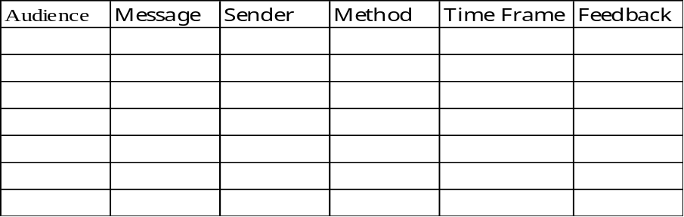
Sample Deliverable - Communication Plan
This document defines the approach for effective communication. Its objective is to ensure the conveyance of the right message by the appropriate sender using the correct channels and vehicles.
Appendix A - Templates
The Communication Plan provides a framework to aggressively manage change and develop ownership:
Audience: Who should we communicate to? Who do we need input from?
  Message: What do we want to communicate? How does it fit into the overall strategy?
  Sender: Who is the most appropriate person(s) to send this message?
  Method: How should we send this message?
  Time Frame: When and how frequently should we send this message?
  Feedback: How will we know if our communication has been successful? How do we create a dialogue with our audience as a method of soliciting feedback?
Proprietary and Confidential to

Slide 21
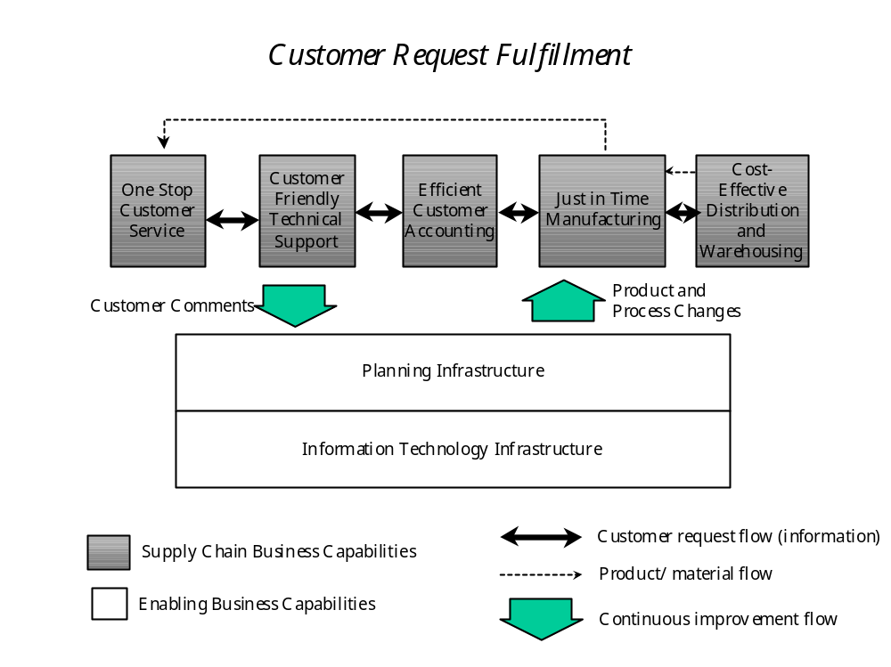
Sample Deliverable - Capability Relationship Diagram
The following is an example of the capability relationship diagram (i.e. Customer Request Fulfillment). This Deliverable visually depicts all the business capabilities in the operating model, including their relationships to each other. Annotations to the picture can include key information, such as where and how the business capabilities interact with each other, as well type and frequency of the interactions.
Proprietary and Confidential to

Slide 22
Sample Del. - Appl. Software Relationship Diagram
The following is an example of the application software relationship diagram (i.e. Dividend Processing Request). The interactions are either direct or through shared data. This Deliverable describes the applications that are part of the business architecture and how they communicate with each other.
European Financial Systems
G/L, Accounts, Project Data
Oracle Applications 11.03
BBS
Financial Applications
Time & Expense
T&E G/L
AP Postings
G/L, A/P, HR, Projects
HTML Application Server
(a.k.a. Self-Service?)
Hyperion
1-6 Silos
DDS
G/L Consolidation
Data
Enterprise Reporting Data
G/L, Accounts,
Project Data
Cashiering
T&E Data - N.A.
Enterprise Reporting System
Landor
Expenses,
Payments
(OFA, Express)
T&E G/L
AP Postings
GEAC
G/L, Accounts,
Project Data
PeopleSoft
T&E G/L
AP Postings
Employee Data
EFT Requests
(Time & Expense)?
ADP
5 - Inbounds (Types)
2 - Outbounds
Proprietary and Confidential to

Slide 23
Definition
Value Proposition
Approach
Roles & Workplan
Case Studies
Sample Deliverables
Job Aids
Proprietary and Confidential to

Slide 24

Job Aids
The following job aids are used during the Business Architecture service offering:
EBS Solutions Planning Methodologies
ERP Sample Business Process Flows
ERP Best Practices
ERP Enablers
Business Integration Knowledge Capital Database
ERP Business Architecture deliverables
BIKC Lotus Notes Database
Case Studies
Proprietary and Confidential to

Slide 25
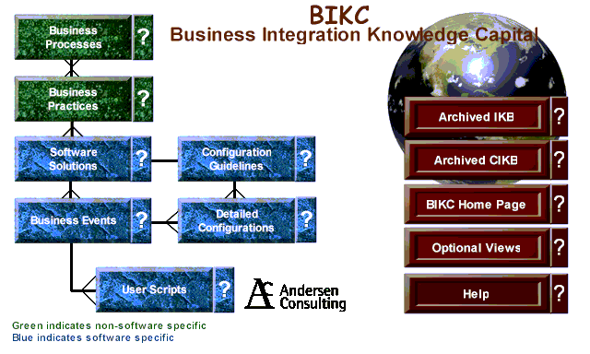
Job Aid - Business Integration Knowledge Capital
The job aid below is the Business Integration Knowledge Capital (BIKC) Lotus Notes database. The BIKC links industry business practices with step-by-step instructions on how those practices are implemented within any ERP (Enterprise Resource Planning) software solution. The BIKC describes implementation from both the end-user and developer perspectives. In addition to its availability on Lotus Notes, the BIKC is available over the internet using the CKN (Client Knowledge Network).
The graphic above represents what you will see when you enter the BIKC database.
Proprietary and Confidential to

Slide 26
EBS Solutions Planning Contact
For Additional Information Contact Marty Mulroe at 312-693-6727
Proprietary and Confidential to

